Slide 1
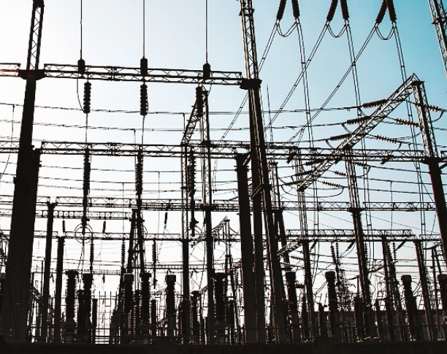
Western Interconnection Power Grid Security
Jayden Lyons
CYBR370
Norwich University
03/07/2020

Slide 2
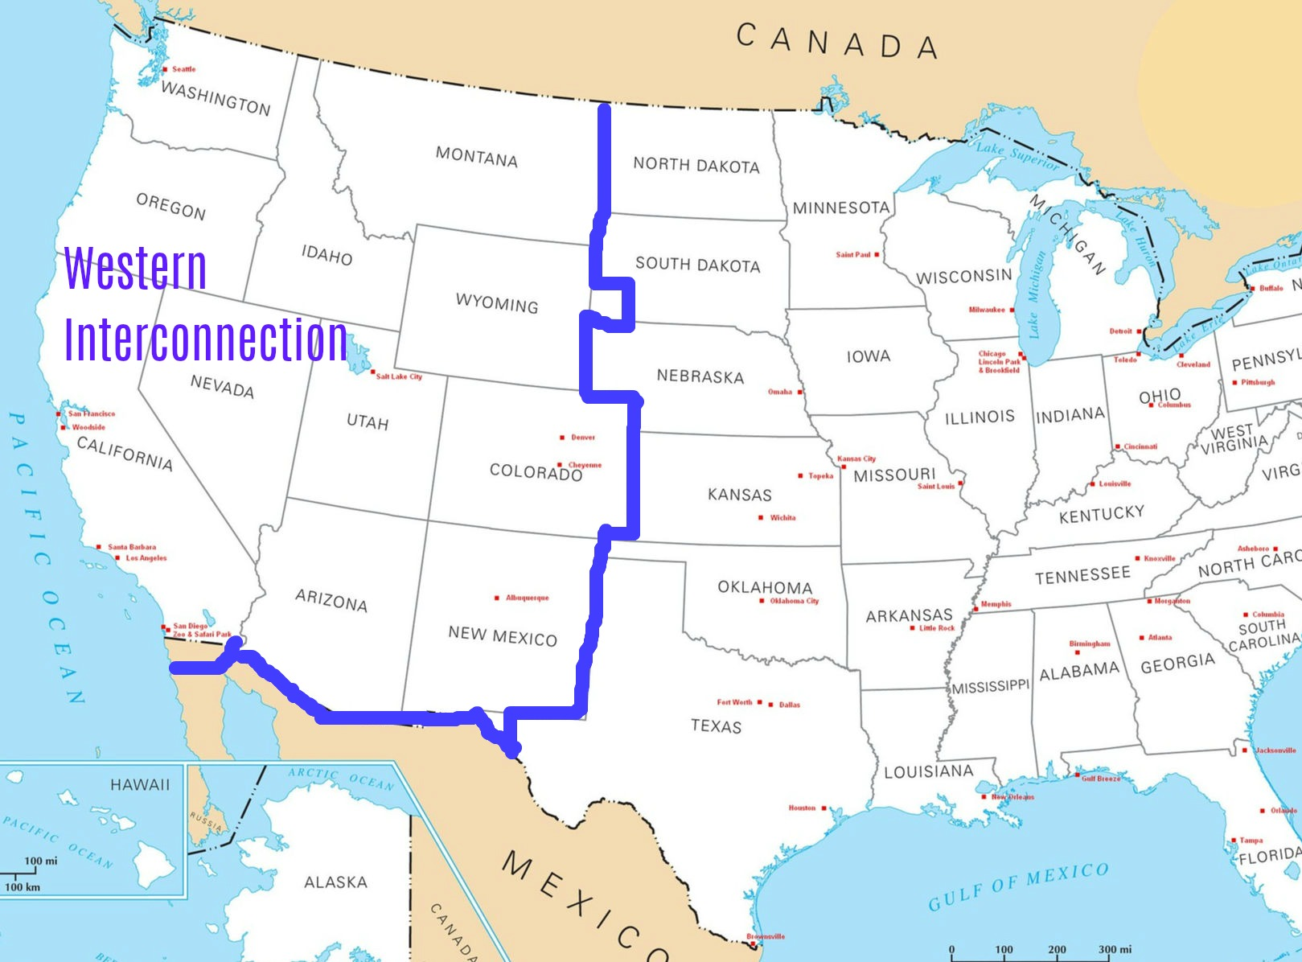
Western Interconnection
GRID SUMMARY:
14 STATES ON WEST COAST
80 MILLION CONSUMERS
136,000 MILES
34 BALANCING AUTHORITIES
500 U.S. CORPORATIONS
DIVERSE TERRAIN
THREATS
NATURAL
OPERATIONAL
HUMAN
PHYSICAL ATTACK
CYBER ATTACK

Slide 3


Adversarial Threats
HIGHEST PRIORITY
NATION-STATE
ADVANCED PERSISTENT THREAT
INDUSTRIAL COMPETITOR
ORGANIZATION
ORGANIZED CRIME
TERRORISM
DOMESTIC COMPETITORS
THIRD-PARTY
GROUP
AD HOC GROUP
POLITICAL HACKTIVISTS
SUPPLIERS
CONTRACTORS
VENDORS
INDIVIDUAL
MEANS
PRIVILEGED INSIDER
MALICIOUS INSIDER
DISGRUNTLED EMPLOYEE
MOTIVE
TRUSTED INSIDER
OUTSIDER
OPPORTUNITY
LOWEST PRIORITY

Slide 4



Cyber Kill Chain
RECONNAISSANCE
WEAPONIZE
DELIVER
EXPLOIT
INSTALL
COMMAND & CONTROL
ACT ON OBJECTIVES
HARDEN SECURITY TO DEFEND AGAINST CYBER ATTACK
NETWORK SEGMENTATION
STRATEGIC PROTOCOL IMPLEMENTATION
APPLICATION WHITELISTING
STRONG PASSWORDS
MULTIFACTOR AUTHENTICATION
END TO END DATA ENCRYPTION
VENDOR & SUPPLY CHAIN MANAGEMENT
CENTRALIZED MONITORING FOR EARLY DETECTION
DEVICE CONFIGURATION
FIREWALL CONFIGURATION
ACCESS CONTROL TO CRITICAL SYSTEMS
SOFTWARE AND FIRMWARE INTEGRITY
WIRELESS ICS NETWORK SECURITY

Slide 5
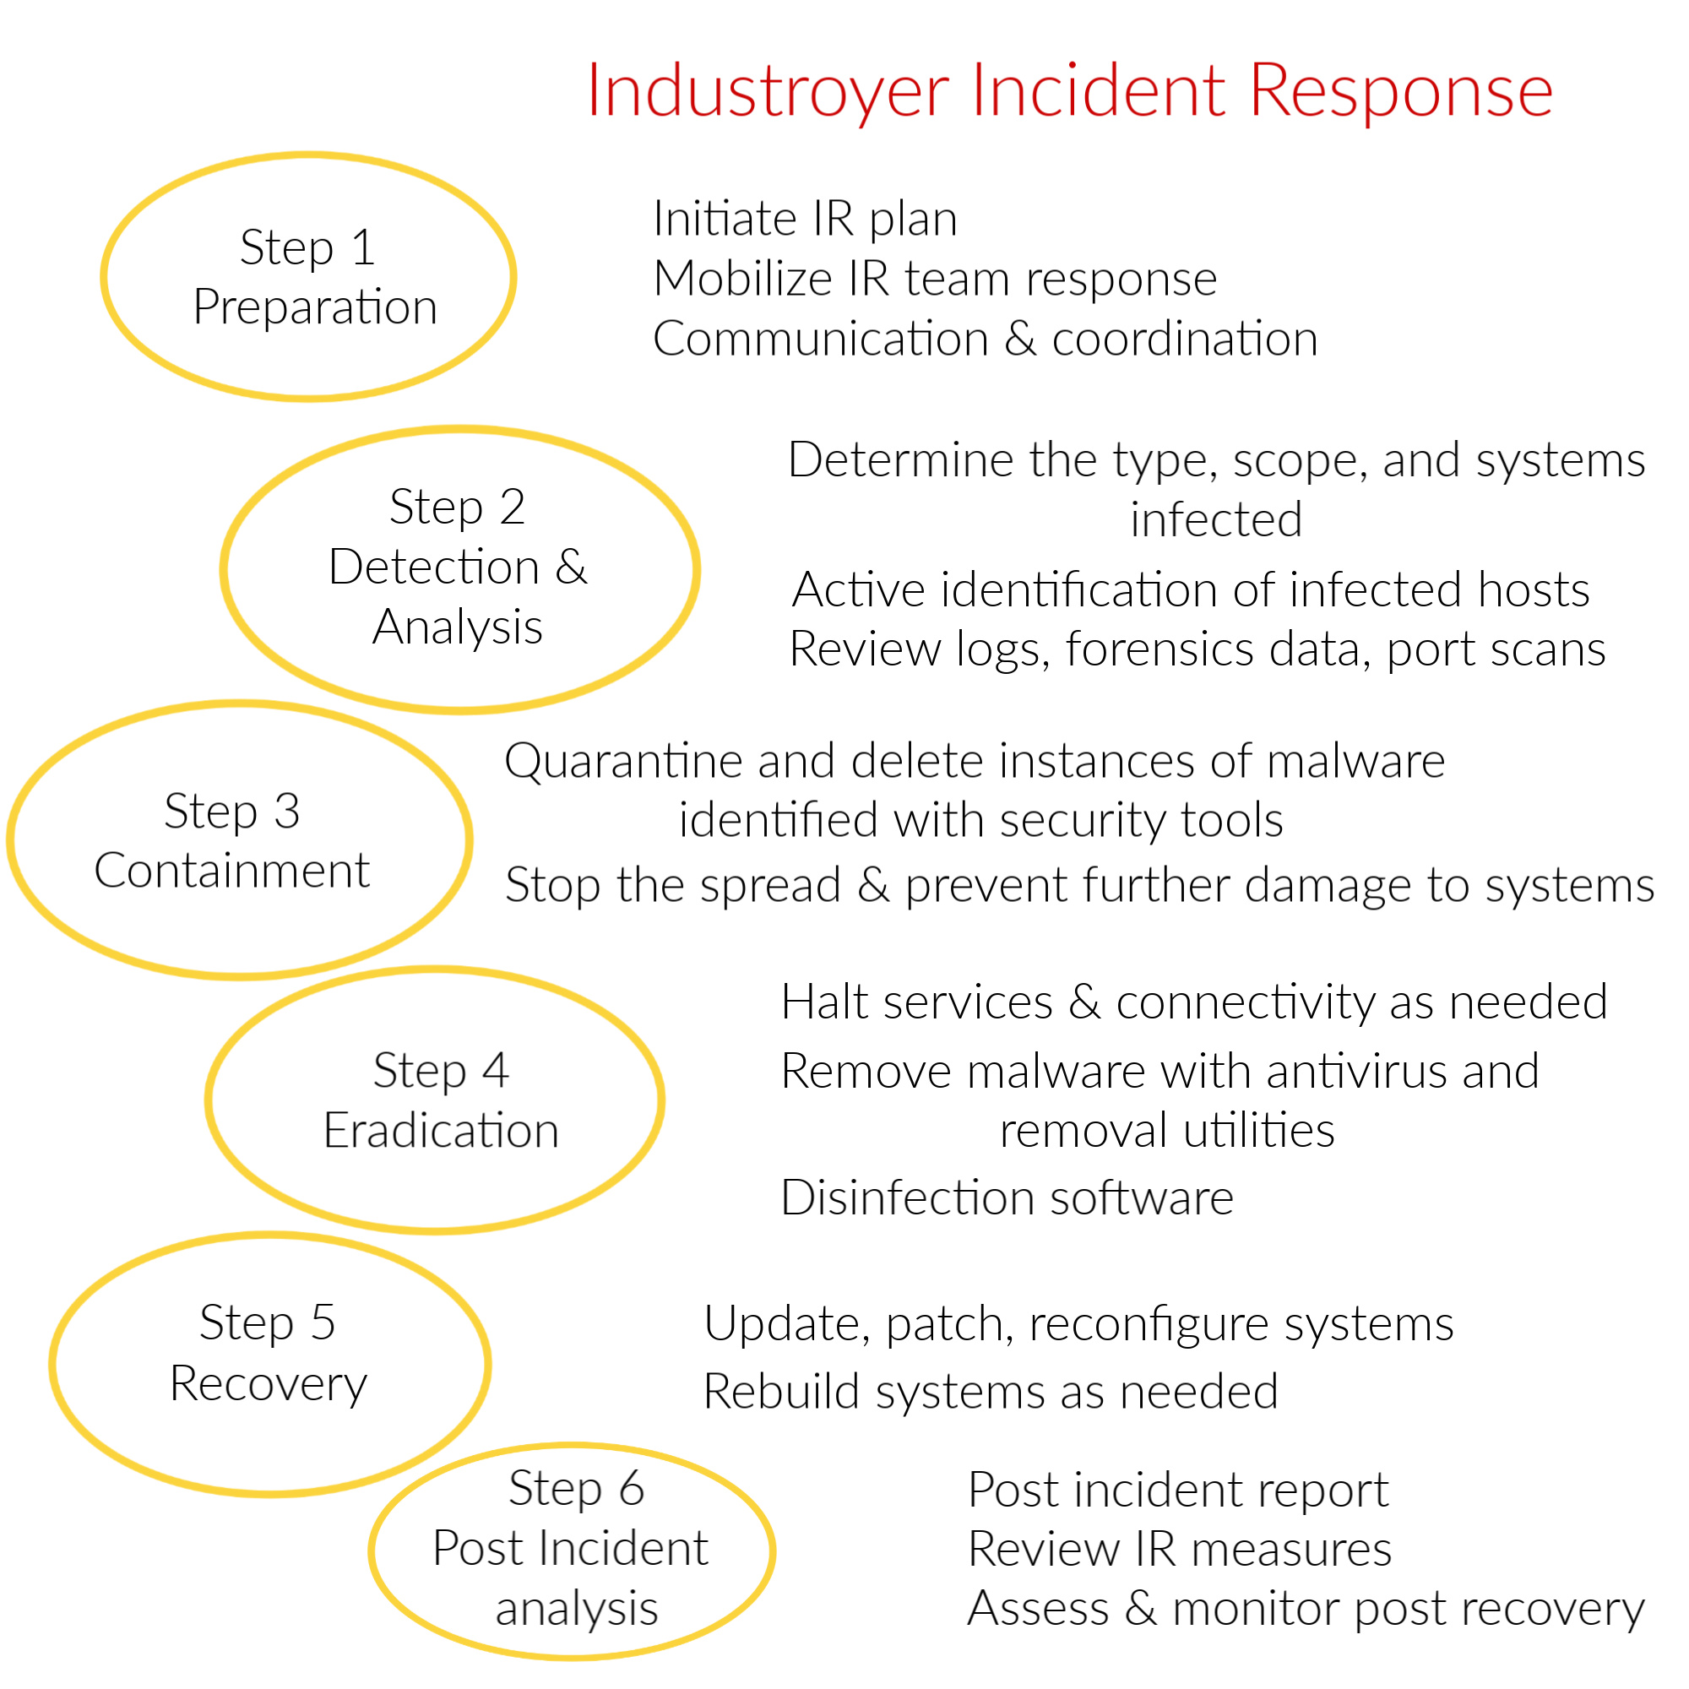
Eradicating
ICS Malware

Slide 6





Industrial Control System Topology
PROGRAMMABLE
LOGIC
CONTROLLER
DISTRIBUTED CONTROL SYSTEM
SUPERVISORY CONTROL &
DATA ACQUISITION
PLC
LAN
WAN
Workstations
Workstations
Human Machine
Interface
Data
Historian
Data
Historian
HMI
Remote
Terminal
Unit
Control Server
Control
Server
PLC
PLC
Measure quantities
and convert to signals
ACTUATORSS
SENSORS
Process signals and
generate variables

Slide 7


















ICS Network Segmentation
INTERNET
INDUSTRIAL CONTROL SYSTEM NETWORK
WAP
IED
RTU
PLC
WIFI
ELECTRIC
GRID
Supervision
Workstations
MASTER
TERMINAL
UNIT
DMZ
Router
GATEWAY
WIRELESS
NETWORK
OT
Workstations
POWER PLANT
IoT
CONTROL
SERVER
RTU
CORPORATE
FIREWALL
PLC
Data
Historian
PLC
Production
Workstations
ELECTRIC
GRID
Servers
CORPORATE NETWORK
SCADA NETWORK
PRODUCTION NETWORK

Slide 8
















Corporate Network Defense In Depth
PHYSICAL LAYER
BUILDING SECURITY
NETWORK LAYER
FIREWALLS
IDS/IPS
SECURITY-CONFIGURED
ROUTERS
SWITCHES
COMPUTER LAYER
ANTIVIRUS SOFTWARE
SECURE UPDATES
SOFTWARE
HOST IDS
APPLICATION LAYER
GATES
LOCKS
GUARDS
KEYCARDS
WLAN
SECURITY
PORT MGMT
DEVICE LAYER
PHYSICAL LEVEL
DATA ENCRYPTION
ACL’s
AUTHENTICATION
PASSWORDS
PACKET FIREWALLS
SECURED ROUTERS
SWITCHES
PAC’s
PLC’s
ACCESS POINT MGMT
NETWORK LEVEL
COMPUTER LEVEL
NAC
APPLICATION LEVEL
DEVICE LEVEL
ENDPOINT PROTOCOLS
ZONED LANs
PERIMETER SECURITY
EXTERNAL CAMERAS

Slide 9


NSA Network Security Model
EMPLOYEE
TRAINING & AWARENESS
PEOPLE
TECHNOLOGY
OPERATIONS
MULTIFACTOR
AUTHENTICATION
INCENTIVES
ACCOUNTABILITY
SECURITY TRAINING
ADMIN PRIVILEGES
TECHNICAL CONTROLS
FIREWALLS
VLANs
DMZ
ENCRYPTION
IDS/IPS
ROUTERS
SIEM
ACLs
FILTERS
UPDATES
PATCHES
KEY MGMT
AUDITS
VENDOR & SUPPLY CHAIN
MGMT
RECOVERY
RESTORATION
INCIDENT RESPONSE
OPERATIONAL PROCEDURES
&
MANAGEMENT

Slide 10

Apply Technical Controls to ICS networks
1
CATEGORIZE
INFORMATION
SYSTEM
2
6
SELECT
SECURITY
CONTROLS
MONITOR
SECURITY
CONTROLS
RISK MANAGEMENT
FRAMEWORK
5
3
AUTHORIZE
INFORMATION
SYSTEM
IMPLEMENT
SECURITY
CONTROLS
4
ASSESS
SECURITY
CONTROLS

Slide 11
Secure the Human Element
SECURITY COMPLIANCE
INCENTIVES &
ENFORCEMENT
MANAGEMENT
OF ADMINISTRATIVE
PRIVILEGES
ACCOUNT MONITORING & CONTROL
EMPLOYEE
SECURITY
TRAINING
MULTIFACTOR
AUTHENTICATION
STRONG
PASSWORD
POLICY
MONITORING & ANALYSIS
OF AUDIT LOGS
ROLE-BASED ACCESS CONTROL
EMPLOYEE
SECURITY AWARENESS
PROGRAM
WIRELESS ACCESS CONTROL
WELL
CONFIGURED
VLANs
SOCIAL
ENGINEERING
AWARENESS
PROGRAMS

Slide 12

Federal ICS Security Standards
U.S. CONGRESS
API 1164 PIPELINE
SCADA SECURITY
ISO/IEC 27019
DEPARTMENT
OF HOMELAND
SECURITY
NERC CRITICAL
INFRASTRUCTURE PROTECTION
NISTIR 7628
FEDERAL
ENERGY
REGULATORY
COMMISSION
DOE SCADA SECURITY
IEC 62351
NERC
DOE CYBERSECURITY PROCUREMENT
LANGUAGE FOR CONTROL SYSTEMS
ENISA – SMART GRIDS
MISSION
ASSURANCE
INDUSTRIAL POWER SYSTEMS

Slide 13
Evolution of Critical Infrastructure Cybersecurity
DIGITAL SMART GRID TECHNOLOGY
2013 HAVEX ICS ATTACK
ARTIFICIAL INTELLIGENCE (AI) APPS FOR ICS NETWORK SECURITY
ENERGY POLICY ACT OF 2005
2014 BLACK ENERGY 2 ICS ATTACK
EVOLVING IT & OT INTEGRATION
SMART GRID INTEGRATION
2016
2020
2022
2010
2024
2017 TRITON ICS ATTACK
ICS DATA ANALYTICS
2007 AURORA ATTACK
2016 INDUSTROYER ICS ATTACK
OPERATIONAL TECHNOLOGY (OT) MARKET EXPANSION
2010 STUXNET SCADA ATTACK
EXPANSION OF IOT DEVICES IN NETWORKS

Slide 14

Cyber Security Checklist and Summary
REVIEW OF WESTERN INTERCONNECTION POWER GRID & INDUSTRIAL CONTROL SYSTEMS
PREPARE AN ORGANIZATIONAL RISK ASSESSMENT INCLUDING THREAT ASSESSMENT
TEST AND ASSESS RISK MANAGEMENT PLAN
DEVELOP AN INCIDENT RESPONSE PLAN
RECOMMENDED NSA DEFENSE IN DEPTH SECURITY FRAMEWORK
IMPLEMENT TECHNOLOGY SECURITY CONTROLS IN MULTIPLE LAYERS
EMPOWER EMPLOYEES WITH SECURITY TRAINING & SOCIAL ENGINEERING AWARENESS PROGRAMS
BEST PRACTICES FOR OPERATIONAL MANAGEMENT AND PROCEDURES
INCIDENT DETECTION, RESPONSE, AND RECOVERY STEPS
RECOMMENDATIONS FOR NETWORK RESILIENCY & ENERGY SECTOR RELIABILITY
RECOMMENDATIONS FOR OPTIMIZING ICS SECURITY & MANAGEMENT

